Slide 1
Chapter 21 - Aspect-oriented Software Development
Lecture 1

Slide 2
Topics covered
The separation of concerns
Aspects, join points and pointcuts
Software engineering with aspects

Slide 3
Aspect-oriented software development
An approach to software development based around a relatively new type of abstraction - an aspect.
Used in conjunction with other approaches - normally object-oriented software engineering.
Aspects encapsulate functionality that cross-cuts and co-exists with other functionality.
Aspects include a definition of where they should be included in a program as well as code implementing the cross-cutting concern.

Slide 4
The separation of concerns
The principle of separation of concerns states that software should be organised so that each program element does one thing and one thing only.
Each program element should therefore be understandable without reference to other elements.
Program abstractions (subroutines, procedures, objects, etc.) support the separation of concerns.

Slide 5
Concerns
Concerns are not program issues but reflect the system requirements and the priorities of the system stakeholders.
Examples of concerns are performance, security, specific functionality, etc.
By reflecting the separation of concerns in a program, there is clear traceability from requirements to implementation.
Core concerns are the functional concerns that relate to the primary purpose of a system; secondary concerns are functional concerns that reflect non-functional and QoS requirements.

Slide 6
Stakeholder concerns
Functional concerns which are related to specific functionality to be included in a system.
Quality of service concerns which are related to the non-functional behaviour of a system.
Policy concerns which are related to the overall policies that govern the use of the system.
System concerns which are related to attributes of the system as a whole such as its maintainability or its configurability.
Organisational concerns which are related to organisational goals and priorities such as producing a system within budget, making use of existing software assets or maintaining the reputation of an organisation.

Slide 7
Cross-cutting concerns
Cross-cutting concerns are concerns whose implementation cuts across a number of program components.
This results in problems when changes to the concern have to be made - the code to be changed is not localised but is in different places across the system.
Cross cutting concerns lead to tangling and scattering.

Slide 8
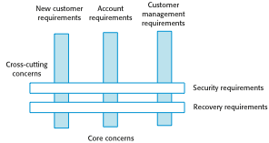
Cross-cutting concerns

Slide 9
Tangling of buffer management and synchronization code
synchronized void put (SensorRecord rec )
{
// Check that there is space in the buffer; wait if not
if ( numberOfEntries == bufsize)
wait () ;
// Add record at end of buffer
store [back] = new SensorRecord (rec.sensorId, rec.sensorVal) ;
back = back + 1 ;
// If at end of buffer, next entry is at the beginning
if (back == bufsize)
back = 0 ;
numberOfEntries = numberOfEntries + 1 ;
// indicate that buffer is available
notify () ;
} // put

Slide 10
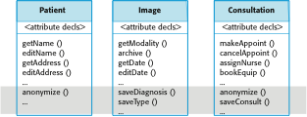
Scattering of methods implementing secondary concerns

Slide 11
Aspects, join points and pointcuts
An aspect is an abstraction which implements a concern. It includes information where it should be included in a program.
A join point is a place in a program where an aspect may be included (woven).
A pointcut defines where (at which join points) the aspect will be included in the program.

Slide 12
Terminology used in aspect-oriented software engineering
Term | Definition
advice | The code implementing a concern.
aspect | A program abstraction that defines a cross-cutting concern. It includes the definition of a pointcut and the advice associated with that concern.
join point | An event in an executing program where the advice associated with an aspect may be executed.
join point model | The set of events that may be referenced in a pointcut.
pointcut | A statement, included in an aspect, that defines the join points where the associated aspect advice should be executed.
weaving | The incorporation of advice code at the specified join points by an aspect weaver.

Slide 13
An authentication aspect
aspect authentication
{ before: call (public void update* (..)) // this is a pointcut {
// this is the advice that should be executed when woven into
// the executing system int tries = 0 ;
string userPassword = Password.Get ( tries ) ; while (tries < 3 && userPassword != thisUser.password ( ) ) { // allow 3 tries to get the password right tries = tries + 1 ; userPassword = Password.Get ( tries ) ; } if (userPassword != thisUser.password ( )) then //if password wrong, assume user has forgotten to logout System.Logout (thisUser.uid) ; }
} // authentication

Slide 14
AspectJ - join point model
Call events
Calls to a method or constructor
Execution events
Execution of a method or constructor
Initialisation events
Class or object initialisation
Data events
Accessing or updating a field
Exception events
The handling of an exception

Slide 15
Pointcuts
Identifies the specific events with which advice should be associated.
Examples of contexts where advice can be woven into a program
Before the execution of a specific method
After the normal or exceptional return from a method
When a field in an object is modified

Slide 16
Aspect weaving
Aspect weavers process source code and weave the aspects into the program at the specified pointcuts.
Three approaches to aspect weaving
Source code pre-processing
Link-time weaving
Dynamic, execution-time weaving

Slide 17
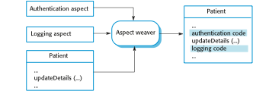
Aspect weaving

Slide 18
Software engineering with aspects
Aspects were introduced as a programming concept but, as the notion of concerns comes from requirements, an aspect oriented approach can be adopted at all stages in the system development process.
The architecture of an aspect-oriented system is based around a core system plus extensions.
The core system implements the primary concerns. Extensions implement secondary and cross-cutting concerns.

Slide 19
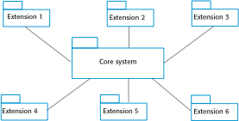
Core system with extensions

Slide 20
Types of extension
Secondary functional extensions
Add extra functional capabilities to the core system
Policy extensions
Add functional capabilities to support an organisational policy such as security
QoS extensions
Add functional capabilities to help attain quality of service requirements
Infrastructure extensions
Add functional capabilities to support the implementation of the system on some platform

Slide 21
Key points
Aspect-oriented approach to software development supports the separation of concerns. By representing cross-cutting concerns as aspects, individual concerns can be understood, reused and modified without changing other parts of the program.
Tangling occurs when a module in a system includes code that implements different system requirements. Scattering occurs when the implementation of a concern is scattered across several components.
Aspects include a pointcut that defines where the aspect will be woven into the program, and advice – the code to implement the cross-cutting concern. Join points are events that can be referenced in a pointcut.
To ensure the separation of concerns, systems can be designed as a core system that implements the primary concerns of stakeholders, and a set of extensions that implement secondary concerns.

Slide 22
Chapter 21 - Aspect-oriented Software Development
Lecture 2

Slide 23
Concern-oriented requirements engineering
An approach to requirements engineering that focuses on customer concerns is consistent with aspect-oriented software development.
Viewpoints are a way to separate the concerns of different stakeholders.
Viewpoints represent the requirements of related groups of stakeholders.
Cross-cutting concerns are concerns that are identified by all viewpoints.

Slide 24
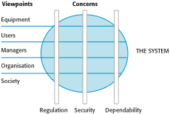
Viewpoints and Concerns

Slide 25
Viewpoints on an equipment inventory system
1. Emergency service users
1.1 Find a specified type of equipment (e.g., heavy lifting gear)
1.2 View equipment available in a specified store
1.3 Check-out equipment
1.4 Check-in equipment
1.5 Arrange equipment to be transported to emergency
1.6 Submit damage report
1.7 Find store close to emergency
2. Emergency planners
2.1 Find a specified type of equipment
2.2 View equipment available in a specified location
2.3 Check-in/cCheck out equipment from a store
2.4 Move equipment from one store to another
2.6 Order new equipment

Slide 26
Viewpoints on an equipment inventory system
3. Maintenance staff
3.1 Check -in/cCheck -out equipment for maintenance
3.2 View equipment available at each store
3.3 Find a specified type of equipment
3.4 View maintenance schedule for an equipment item
3.5 Complete maintenance record for an equipment item
3.6 Show all items in a store requiring maintenance

Slide 27
Availability-related requirements for the equipment inventory system
AV.1 There shall be a ‘hot standby’ system available in a location that is geographically well-separated from the principal system.
Rationale: The emergency may affect the principal location of the system.
AV.1.1 All transactions shall be logged at the site of the principal system and at the remote standby site.
Rationale: This allows these transactions to be replayed and the system databases made consistent.
AV.1.2 The system shall send status information to the emergency control room system every five minutes.
Rationale: The operators of the control room system can switch to the hot standby if the principal system is unavailable.

Slide 28
Inventory system - core requirements
C.1 The system shall allow authorised users to view the description of any item of equipment in the emergency services inventory.
C.2 The system shall include a search facility to allow authorised users to search either individual inventories or the complete inventory for a specific item or type of equipment.

Slide 29
Inventory system - extension requirements
E1.1 It shall be possible for authorised users to place orders with accredited suppliers for replacement items of equipment.
E1.1.1 When an item of equipment is ordered, it should be allocated to a specific inventory and flagged in that inventory as ‘on order’.

Slide 30
Aspect-oriented design/programming
Aspect-oriented design
The process of designing a system that makes use of aspects to implement the cross-cutting concerns and extensions that are identified during the requirements engineering process.
Aspect-oriented programming
The implementation of an aspect-oriented design using an aspect-oriented programming language such as AspectJ.

Slide 31
Use-cases
A use-case approach can serve as a basis for aspect-oriented software engineering.
Each use case represents an aspect.
Extension use cases naturally fit the core + extensions architectural model of a system
Jacobsen and Ng develop these ideas of using use-cases by introducing new concepts such as use-case slices and use case modules.

Slide 32
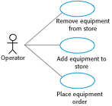
Use cases from the inventory management system

Slide 33

Extension use cases

Slide 34
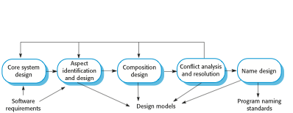
A generic aspect-oriented design process

Slide 35
Design activities
Core system design where you design the system architecture to support the core functionality of the system.
Aspect identification and design Starting with the extensions identified in the system requirements, you should analyze these to see if they are aspects in themselves or if they should be broken down into several aspects.
Composition design At this stage, you analyze the core system and aspect designs to discover where the aspects should be composed with the core system. Essentially, you are identifying the join points in a program at which aspects will be woven.

Slide 36
Design activities
Conflict analysis and resolution Conflicts occur when there is a pointcut clash with different aspects specifying that they should be composed at the same point in the program.
Name design is essential to avoid the problem of accidental pointcuts. These occur when, at some program join point, the name accidentally matches that in a pointcut pattern. The advice is therefore unintentionally applied at that point.

Slide 37
UML extensions
Expressing an aspect oriented design in the UML requires:
A means of modelling aspects using UML stereotypes.
A means of specifying the join points where the aspect advice is to be composed with the core system.

Slide 38
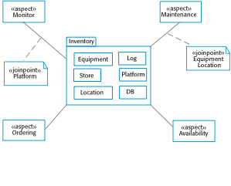
An aspect-oriented design model

Slide 39
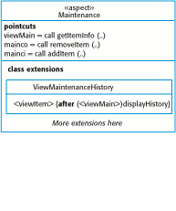
Part of a model of an aspect

Slide 40
Extension statement
In the method viewItem, after the call to the method getItemInfo, a call to the method displayHistory should be included to display the maintenance record

Slide 41
Verification and validation
The process of demonstrating that a program meets it specification (verification) and meets the real needs of its stakeholders (validation)
Like any other systems,aspect-oriented systems can be tested as black-boxes using the specification to derive the tests
However, program inspections and ‘white-box’ testing that relies on the program source code is problematic.
Aspects also introduce additional testing problems

Slide 42
Program inspection problems
To inspect a program (in a conventional language) effectively, you should be able to read it from right to left and top to bottom.
Aspects make this impossible as the program is a web rather than a sequential document. You can’t tell from the source code where an aspect will be woven and executed.
Flattening an aspect-oriented program for reading is practically impossible.

Slide 43
White box testing
The aim of white box testing is to use source code knowledge to design tests that provide some level of program coverage e.g. each logical branch in a program should be executed at least once.
Aspect problems
How can source code knowledge be used to derive tests?
What exactly does test coverage mean?

Slide 44
Aspect problems
Deriving a program flow graph of a program with aspects is impossible. It is therefore difficult to design tests systematically that ensure that all combinations of base code and aspects are executed.
What does test coverage mean?
Code of each aspect executed once?
Code of each aspect exeucted once at each join point where aspect woven?
???

Slide 45
Testing problems with aspects
How should aspects be specified so that tests can be derived?
How can aspects be tested independently of the base system?
How can aspect interference be tested?
How can tests be designed so that all join points are executed and appropriate aspect tests applied?

Slide 46
Key points
To identify concerns, you may use a viewpoint-oriented approach to requirements engineering to elicit stakeholder requirements and to identify cross-cutting quality of service and policy concerns.
The transition from requirements to design can be made by identifying use cases, where each use case represents a stakeholder concern.
The problems of inspecting and deriving tests for aspect-oriented programs are a significant barrier to the adoption of aspect-oriented software development in large software projects.

